Slide 1
H2_LBW_Analysis_Jan2023
File created on: 1/14/23 9:18:38 AM MST

Slide 2
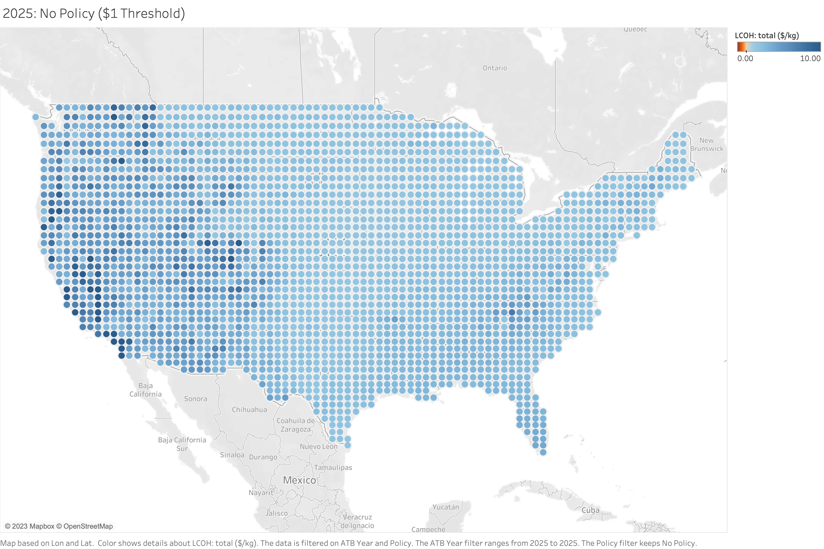
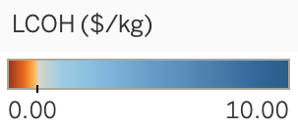

Slide 3
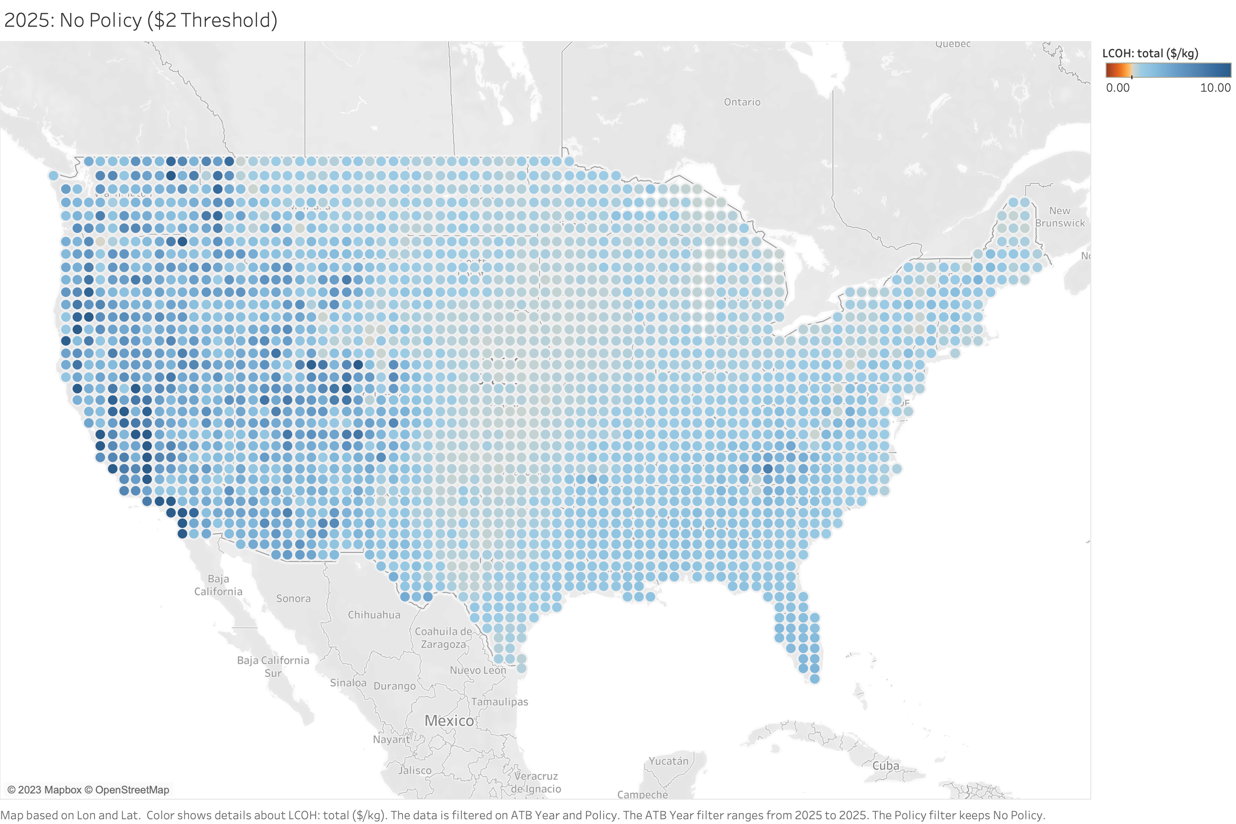
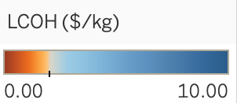

Slide 4
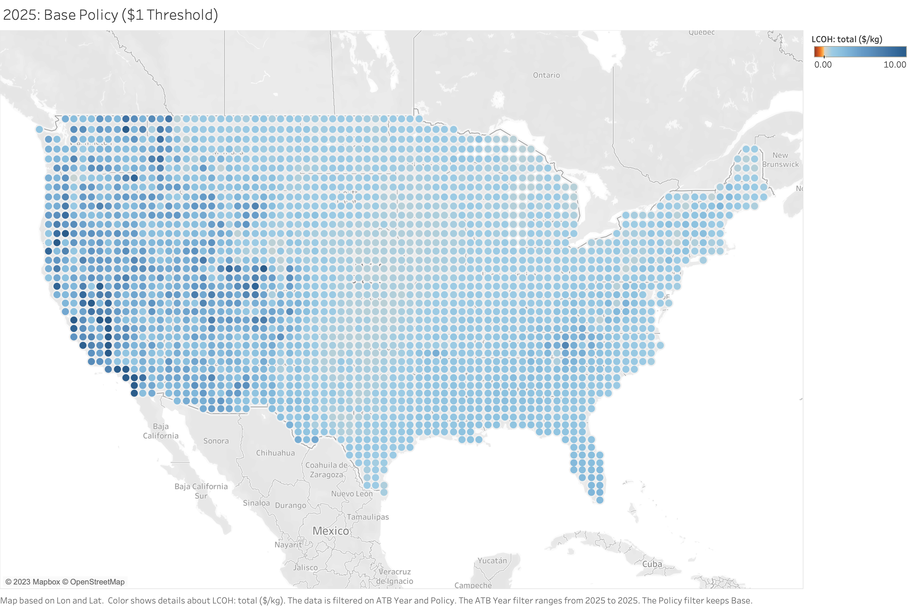

Slide 5
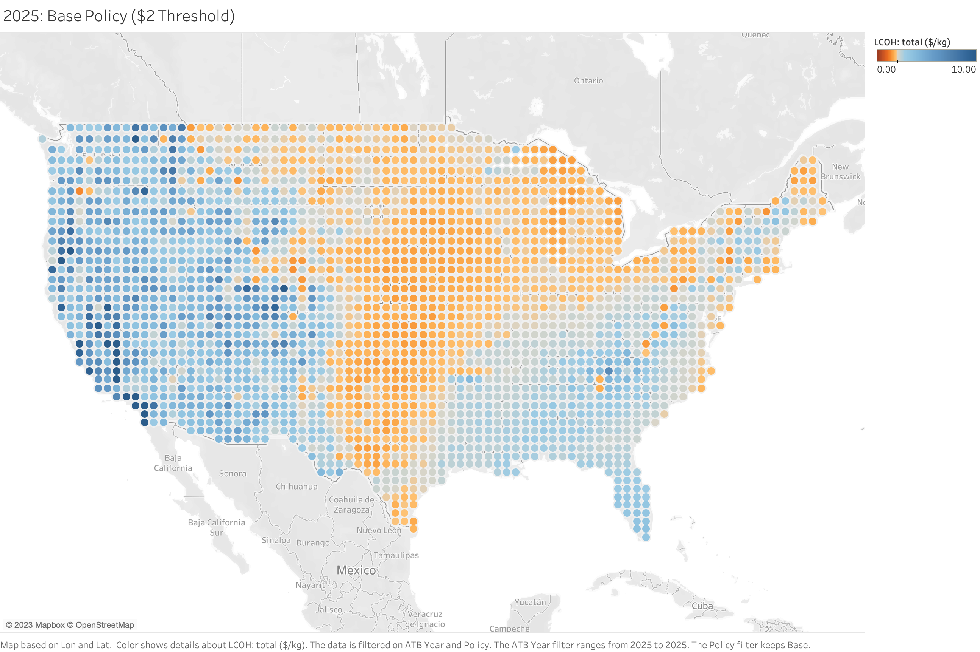

Slide 6
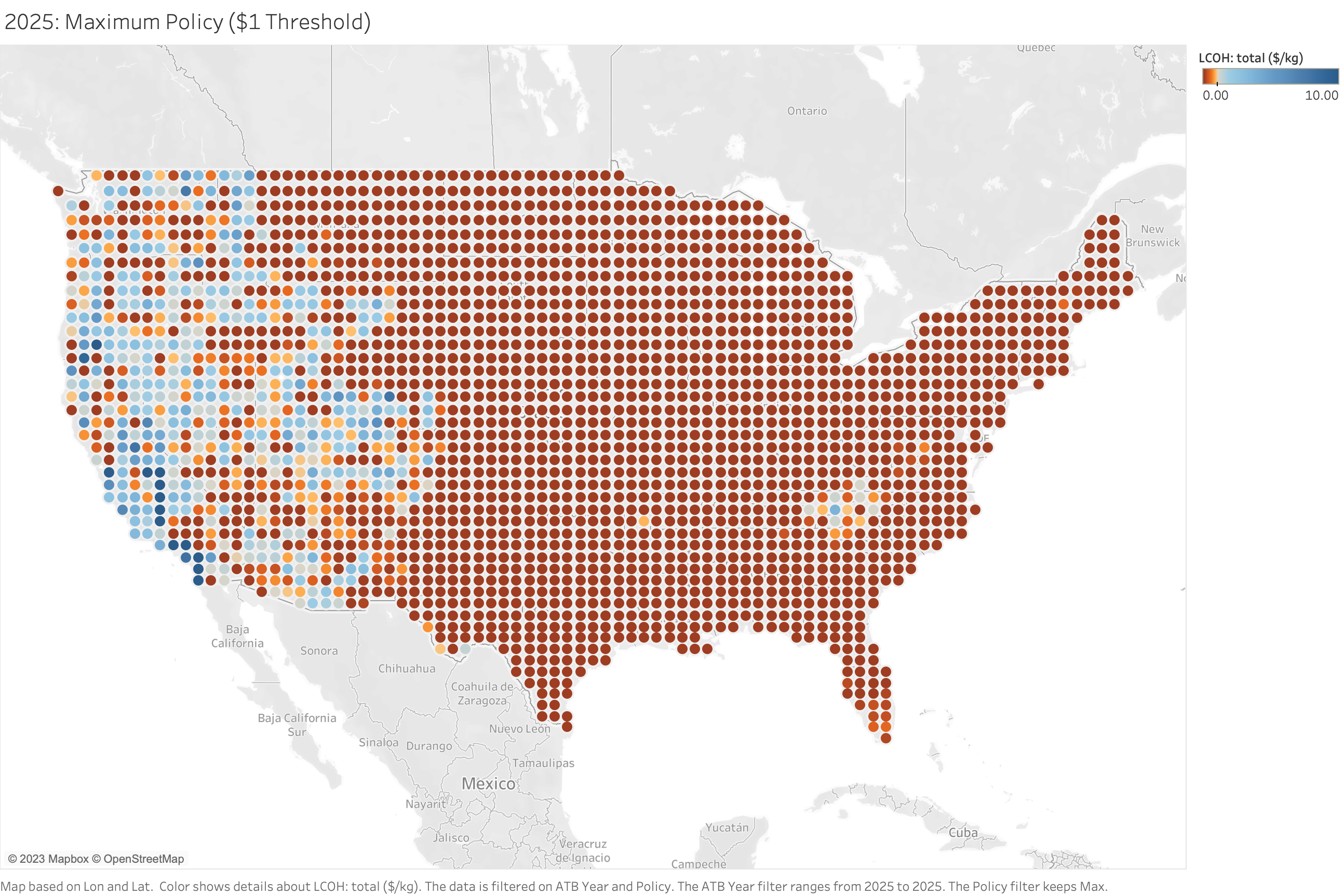

Slide 7
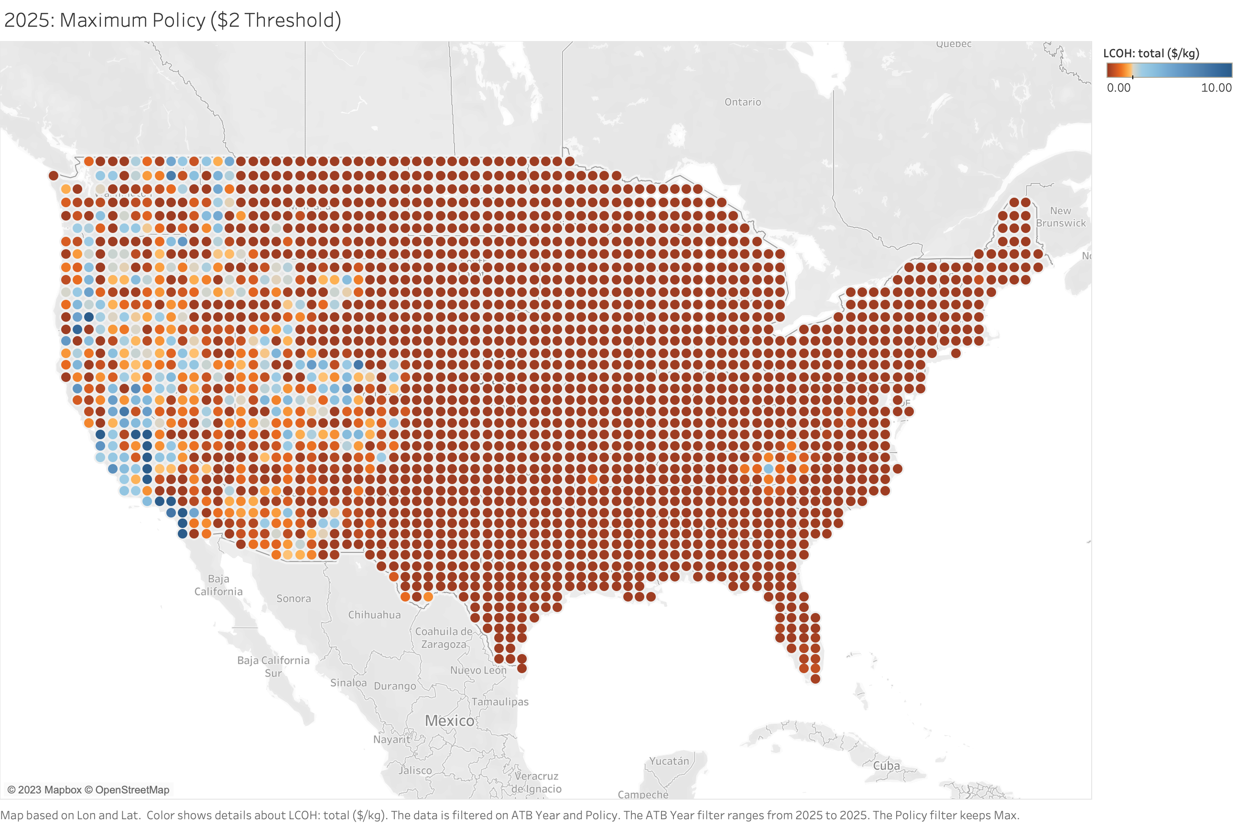

Slide 8


Slide 9
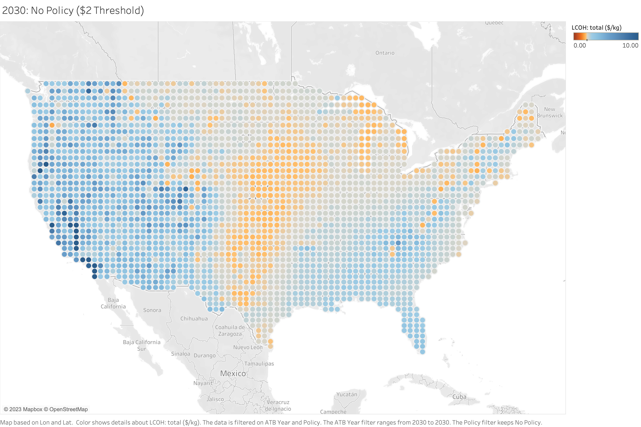

Slide 10
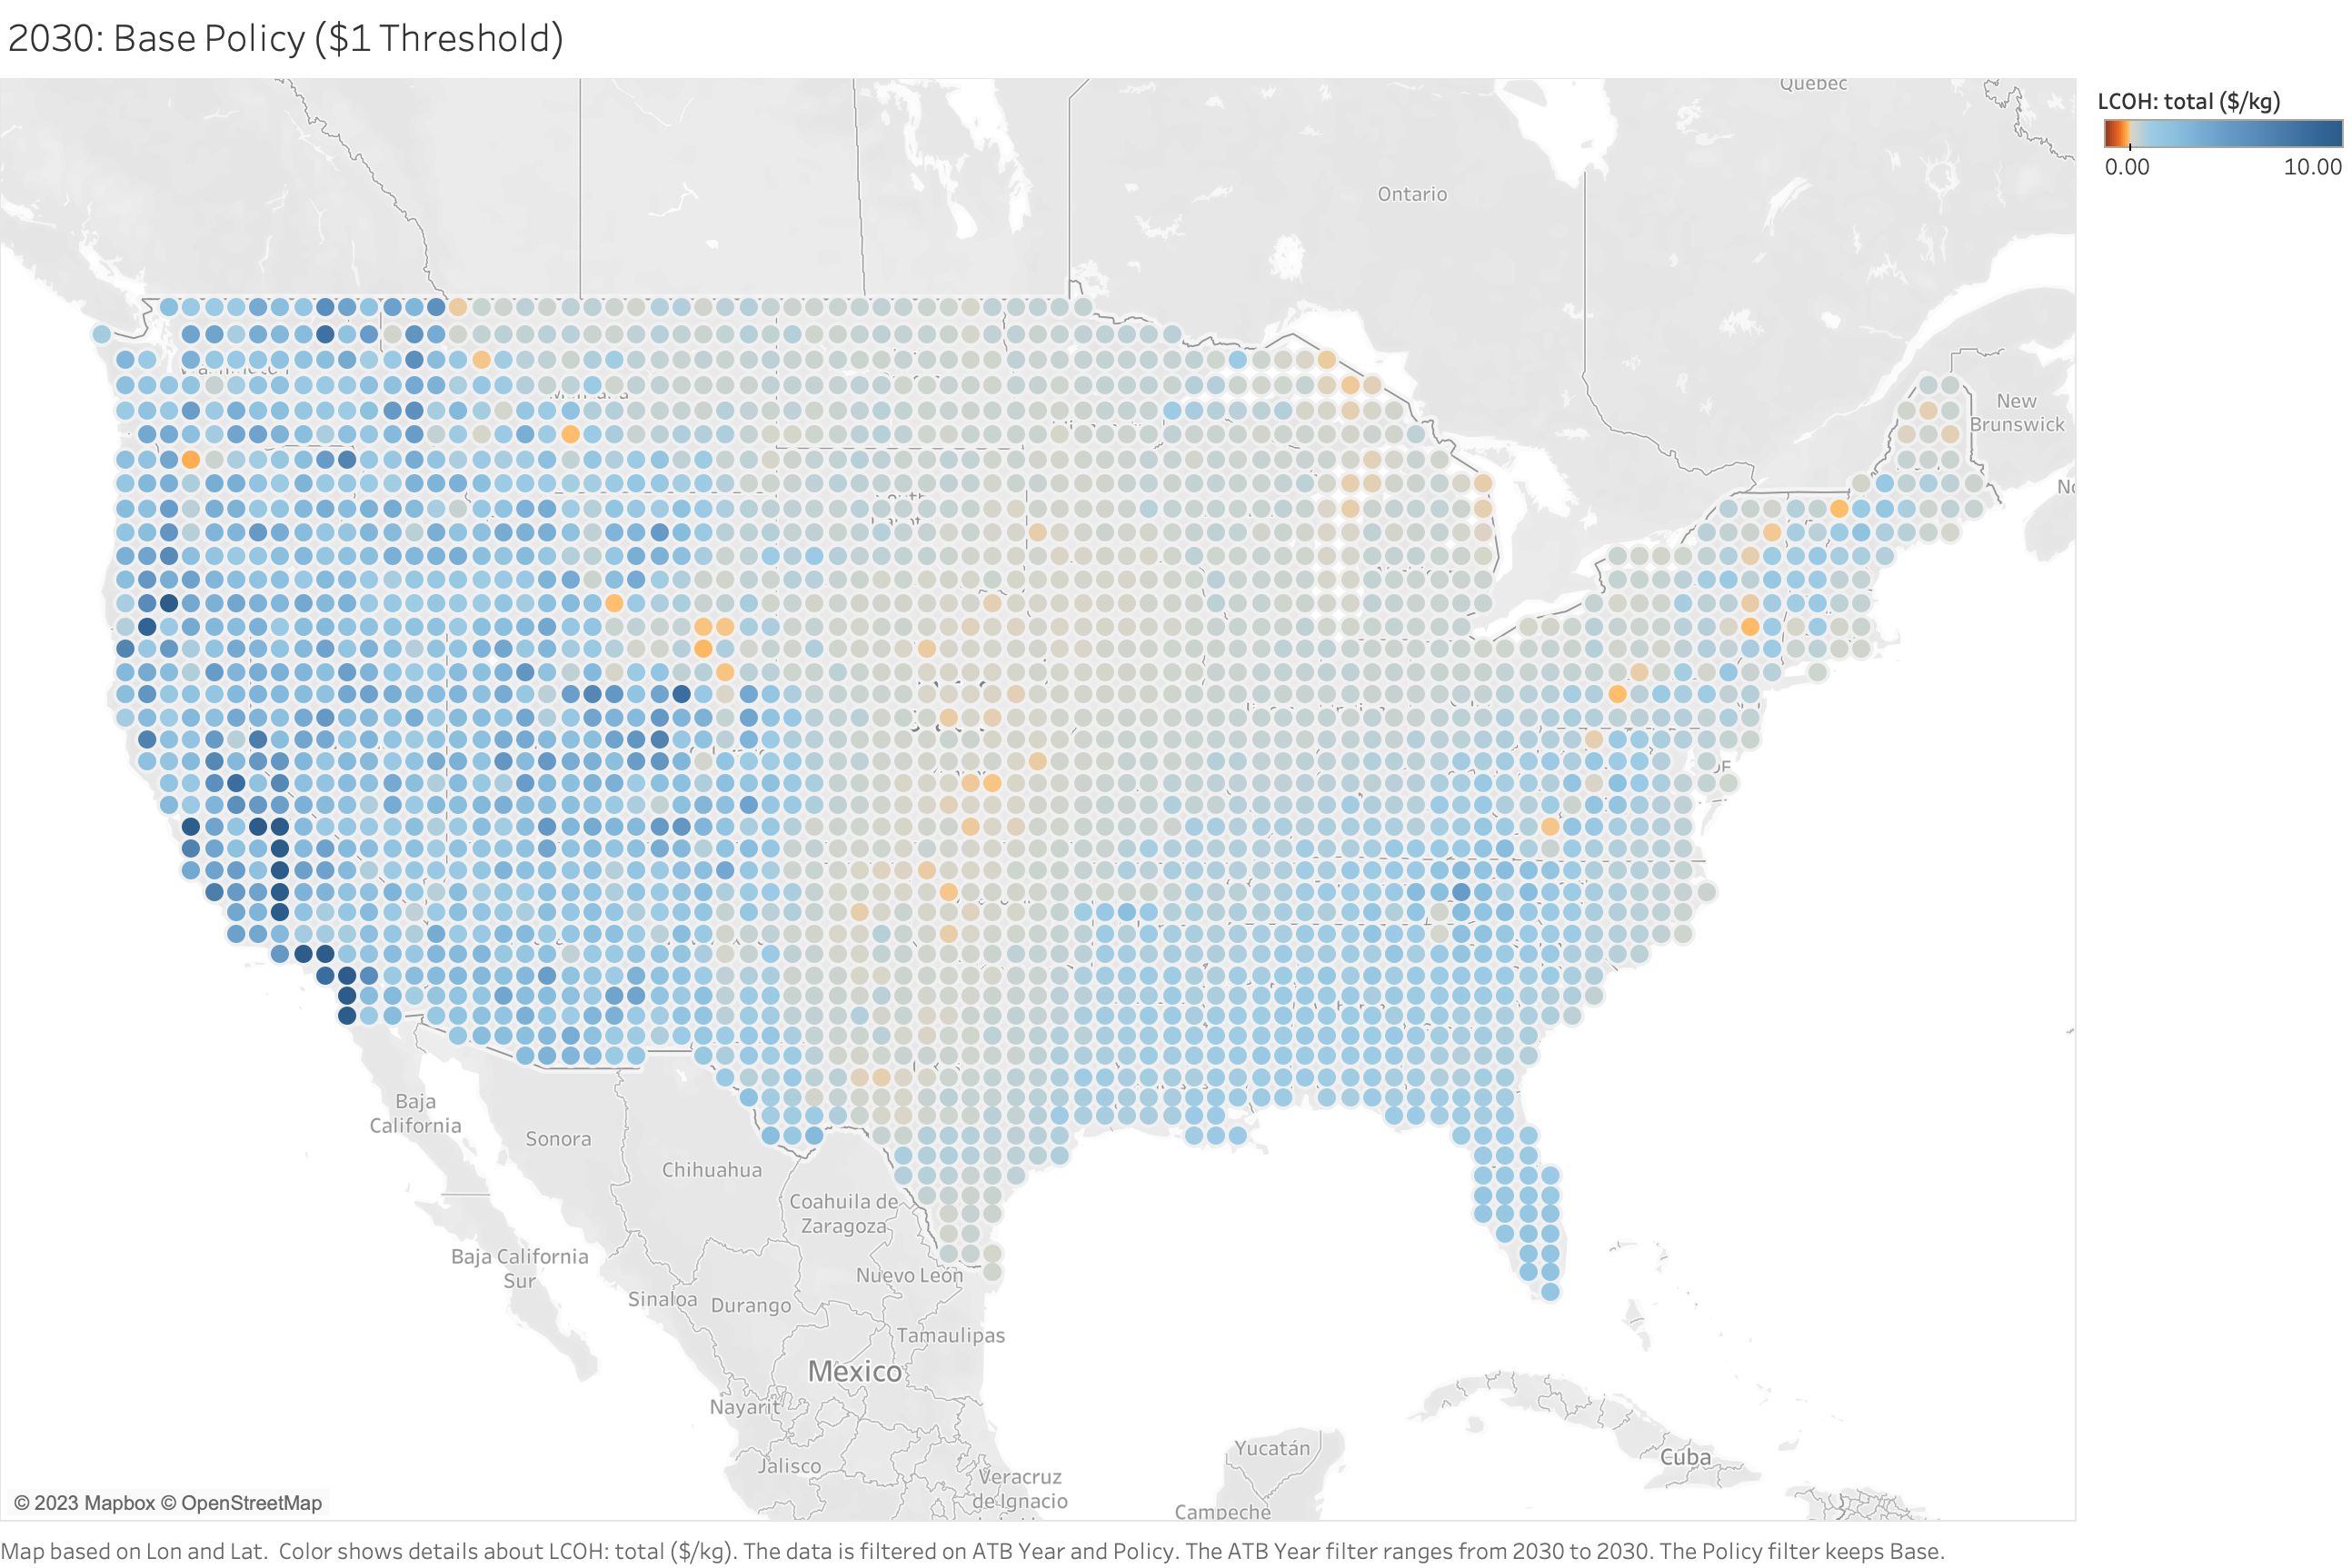

Slide 11
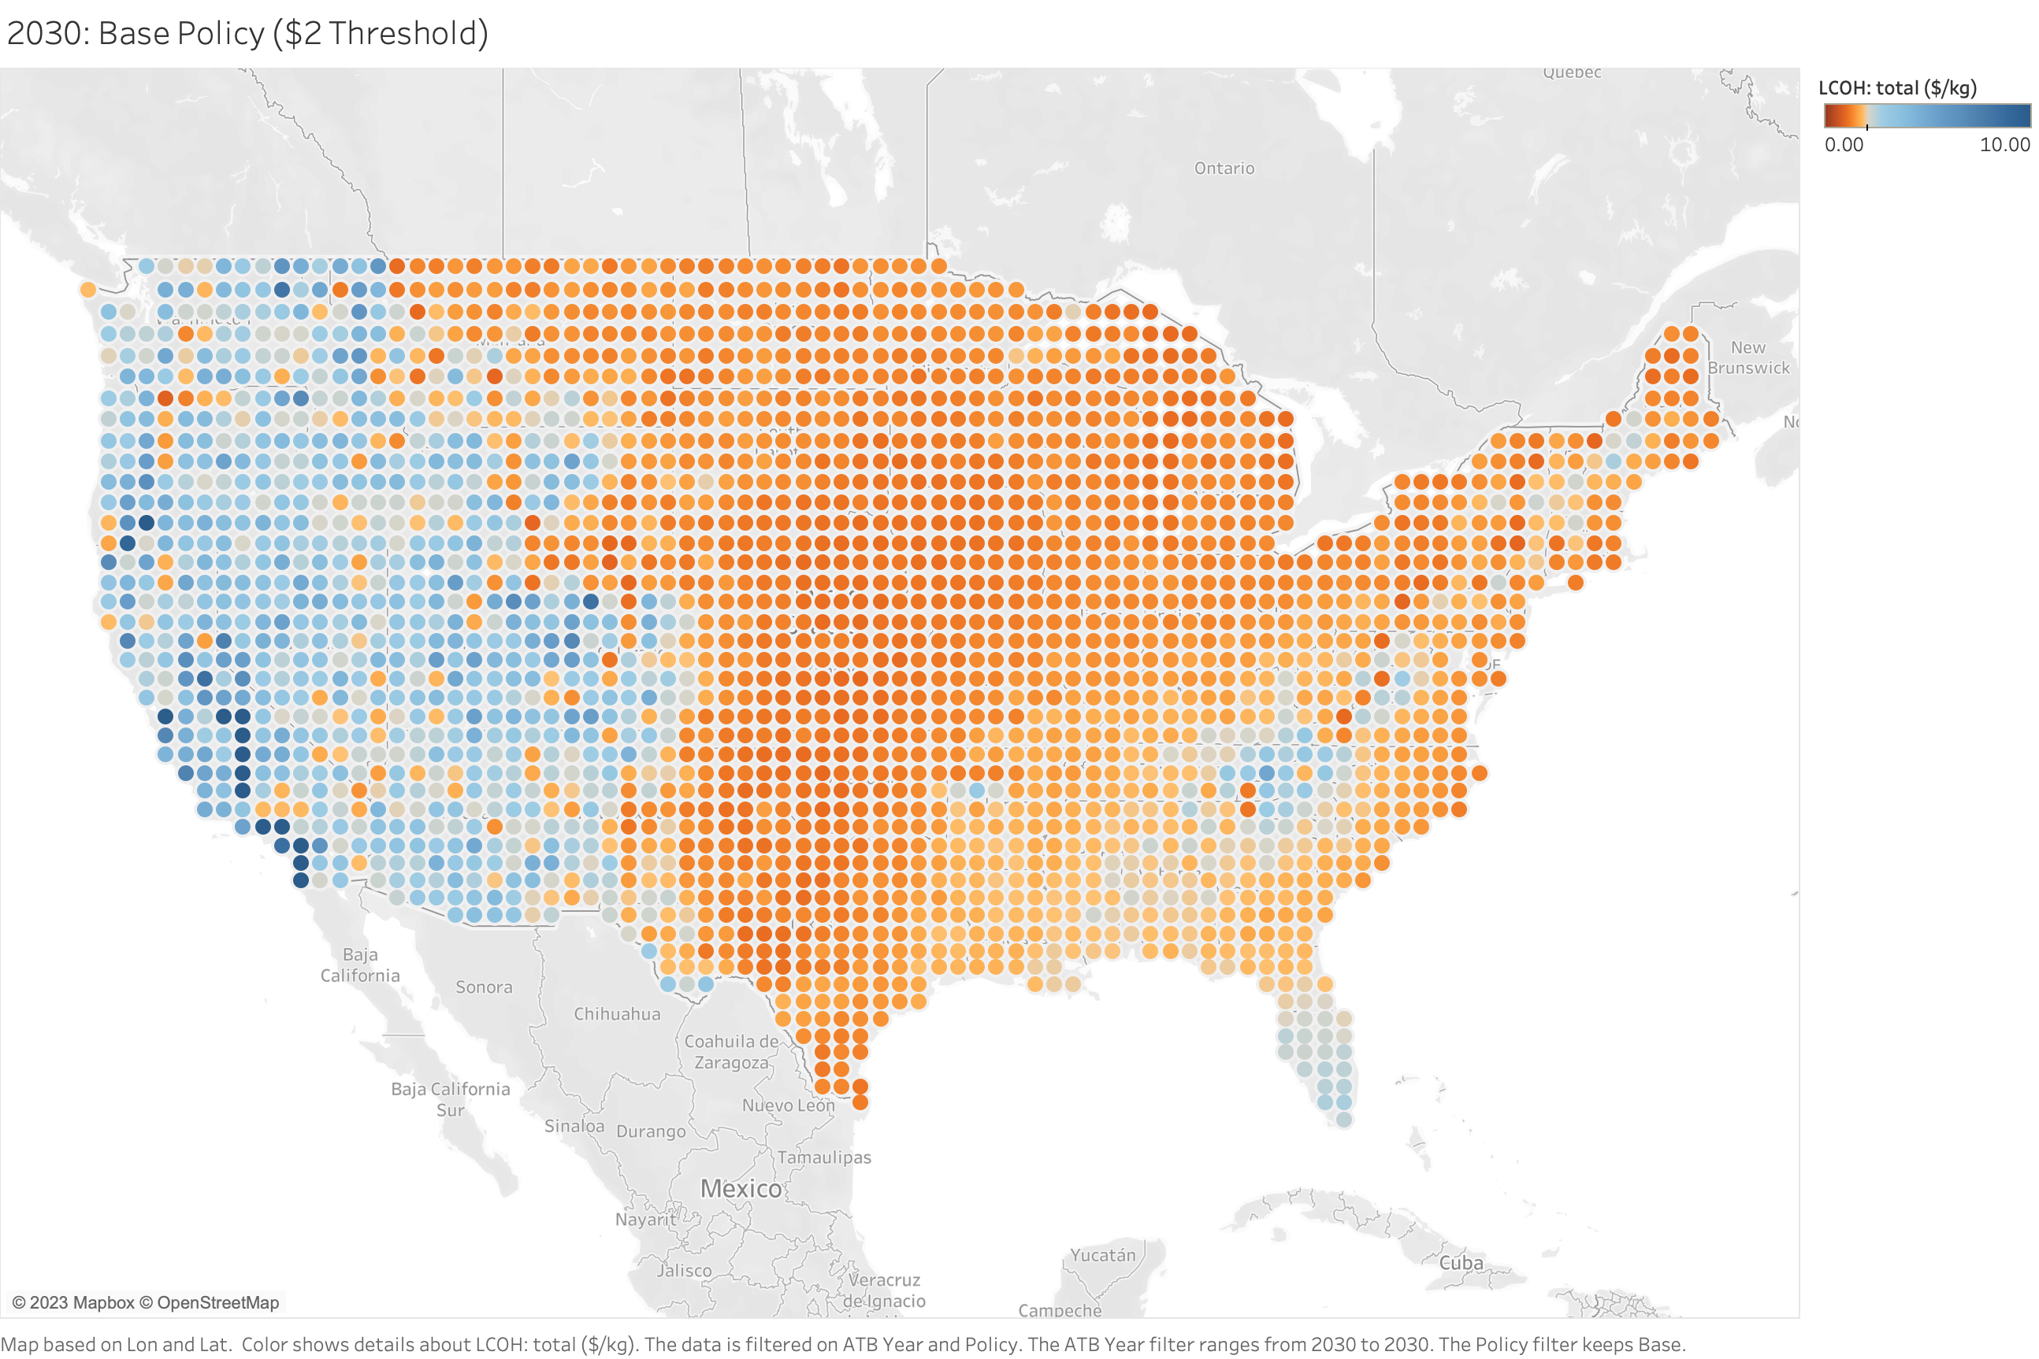

Slide 12


Slide 13
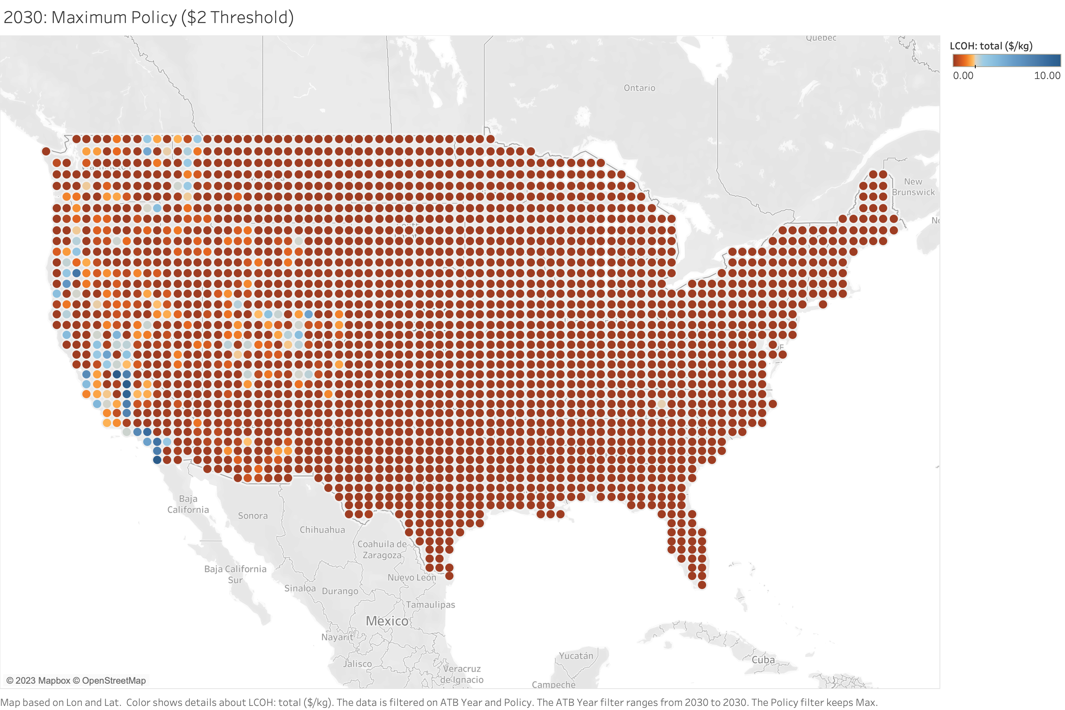

Slide 14


Slide 15
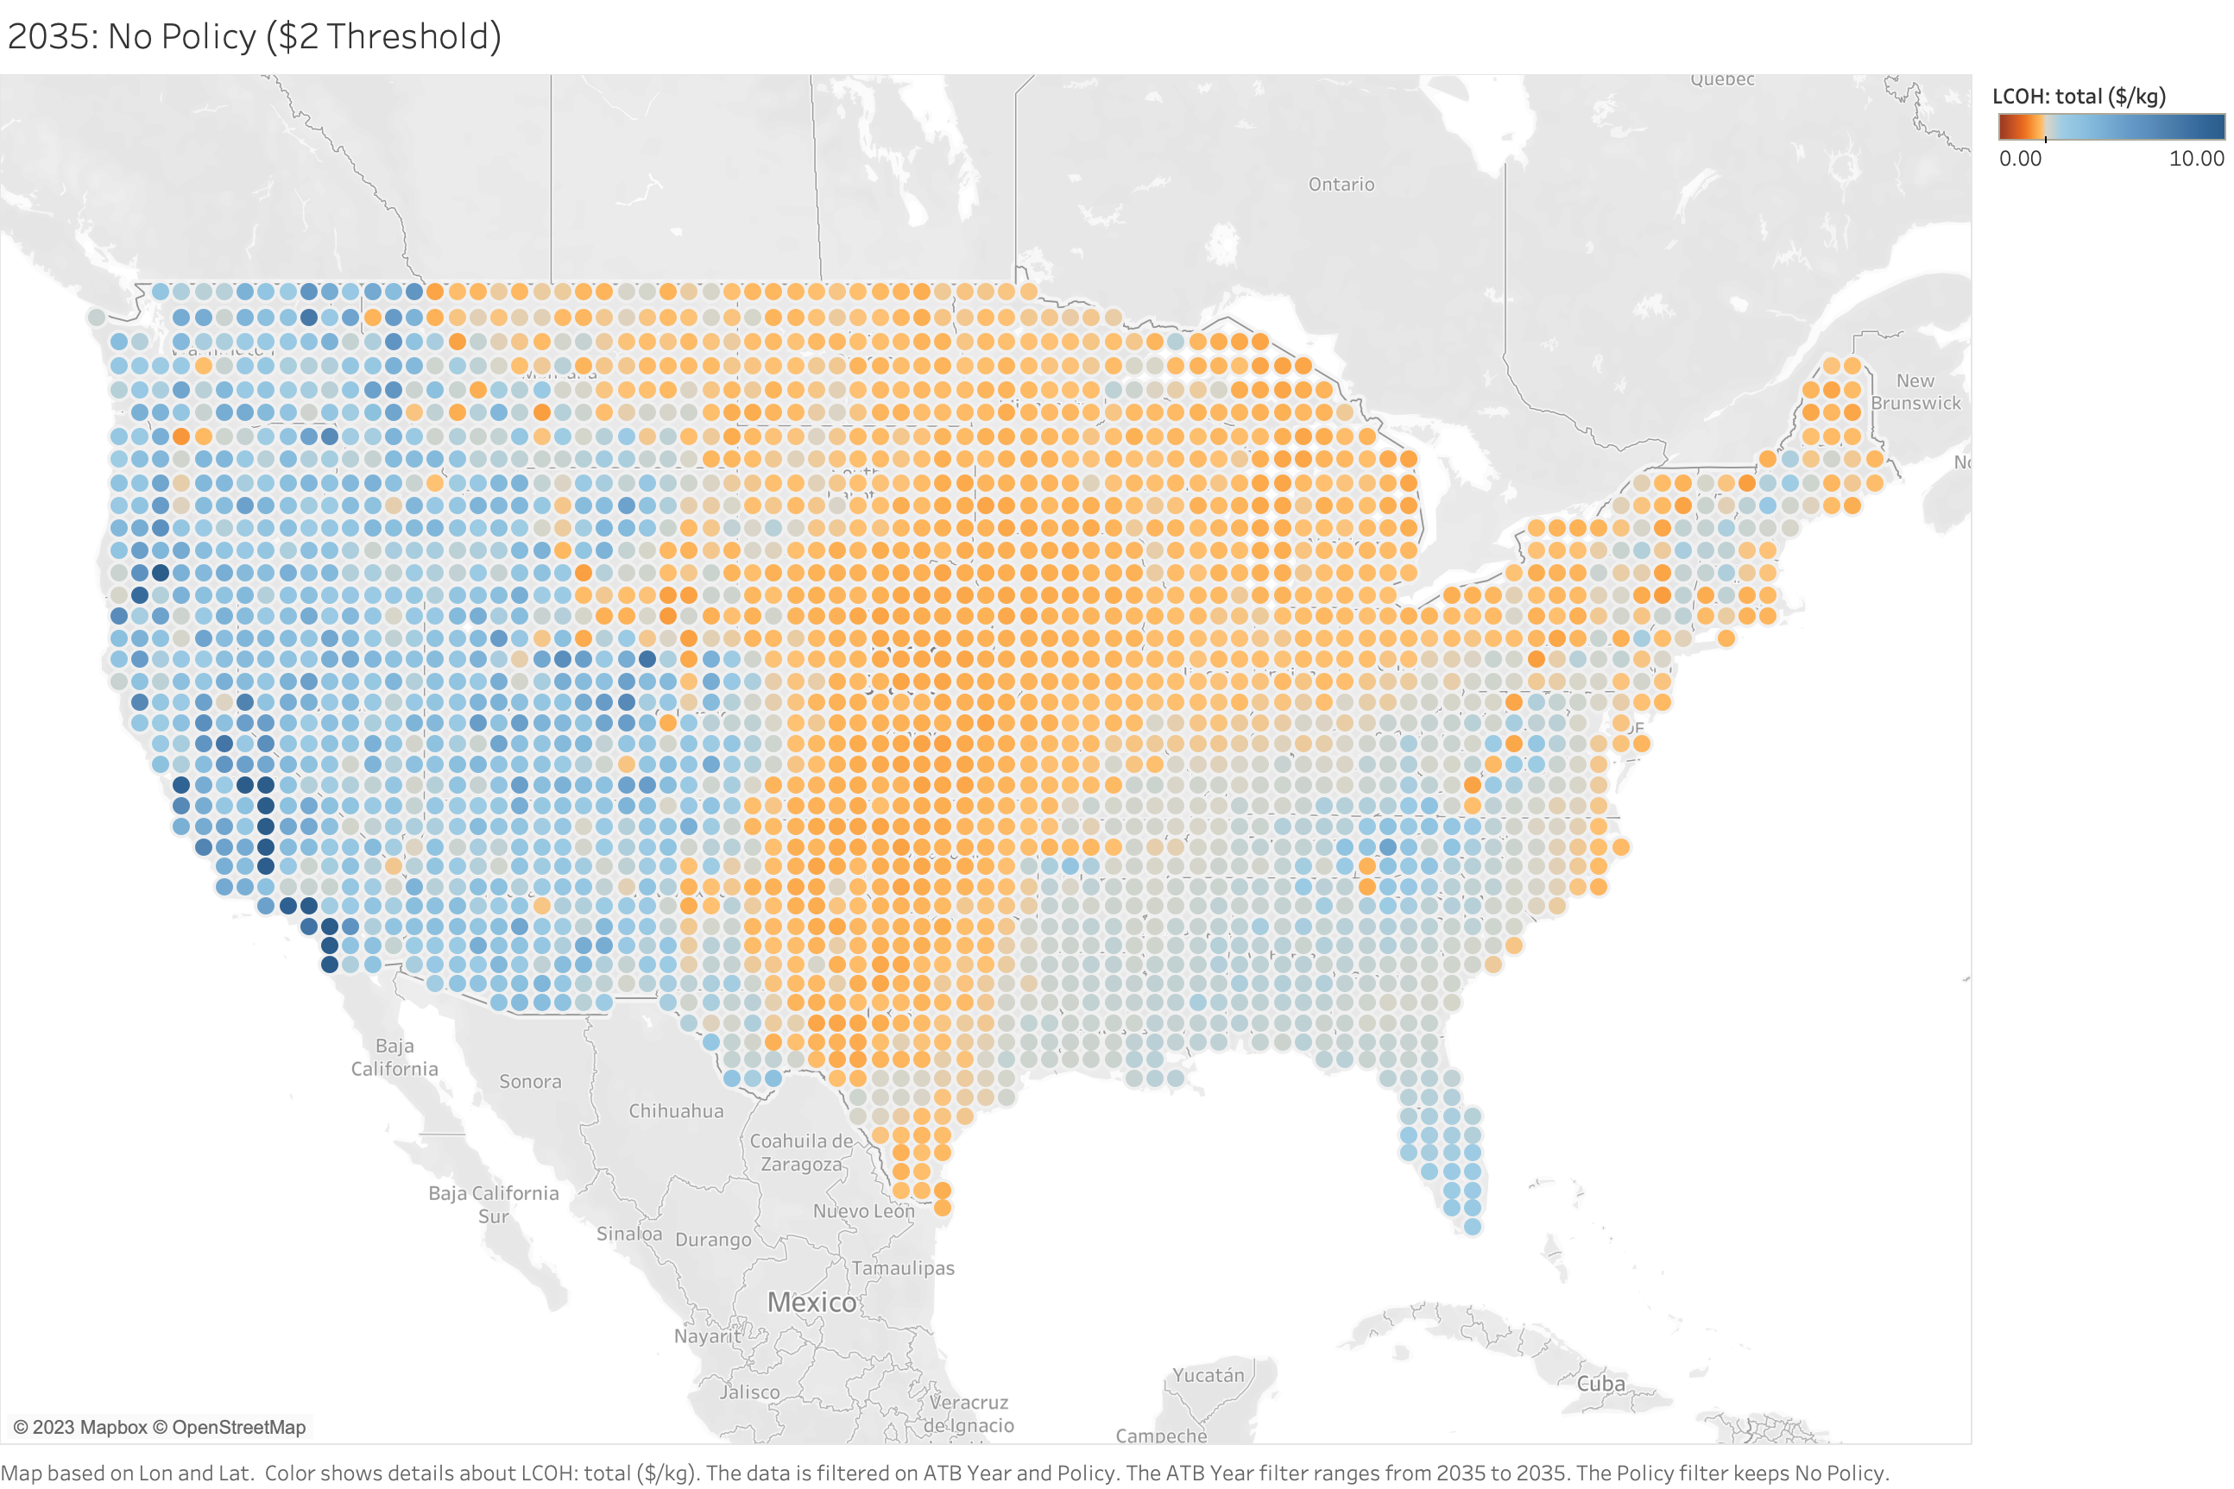

Slide 16
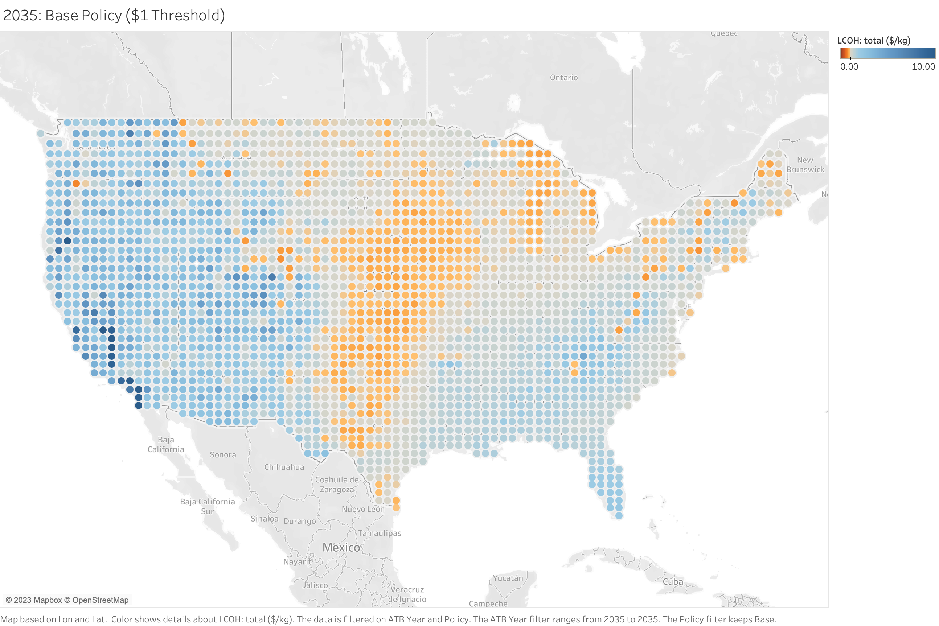

Slide 17
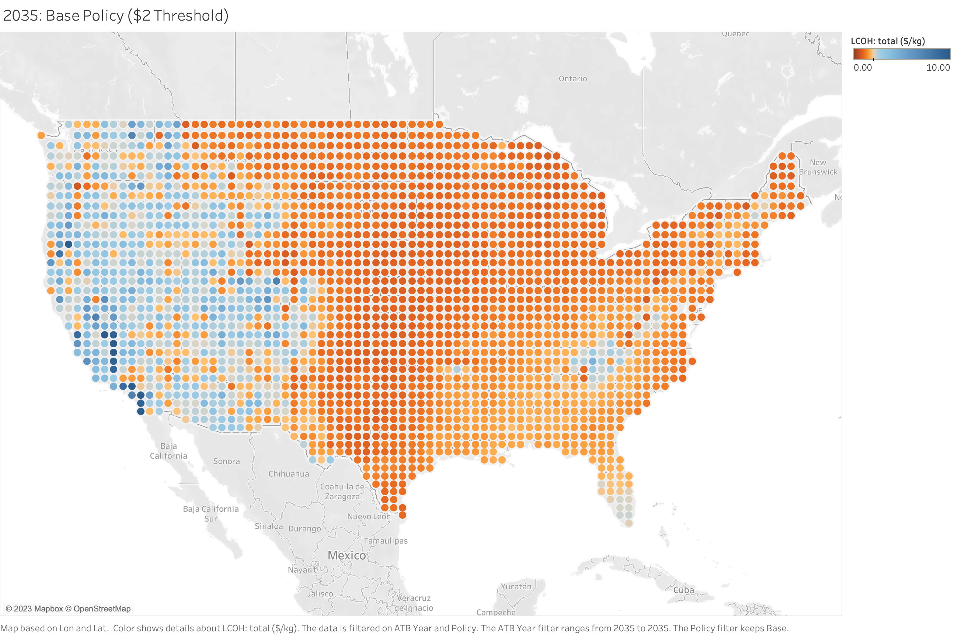

Slide 18


Slide 19
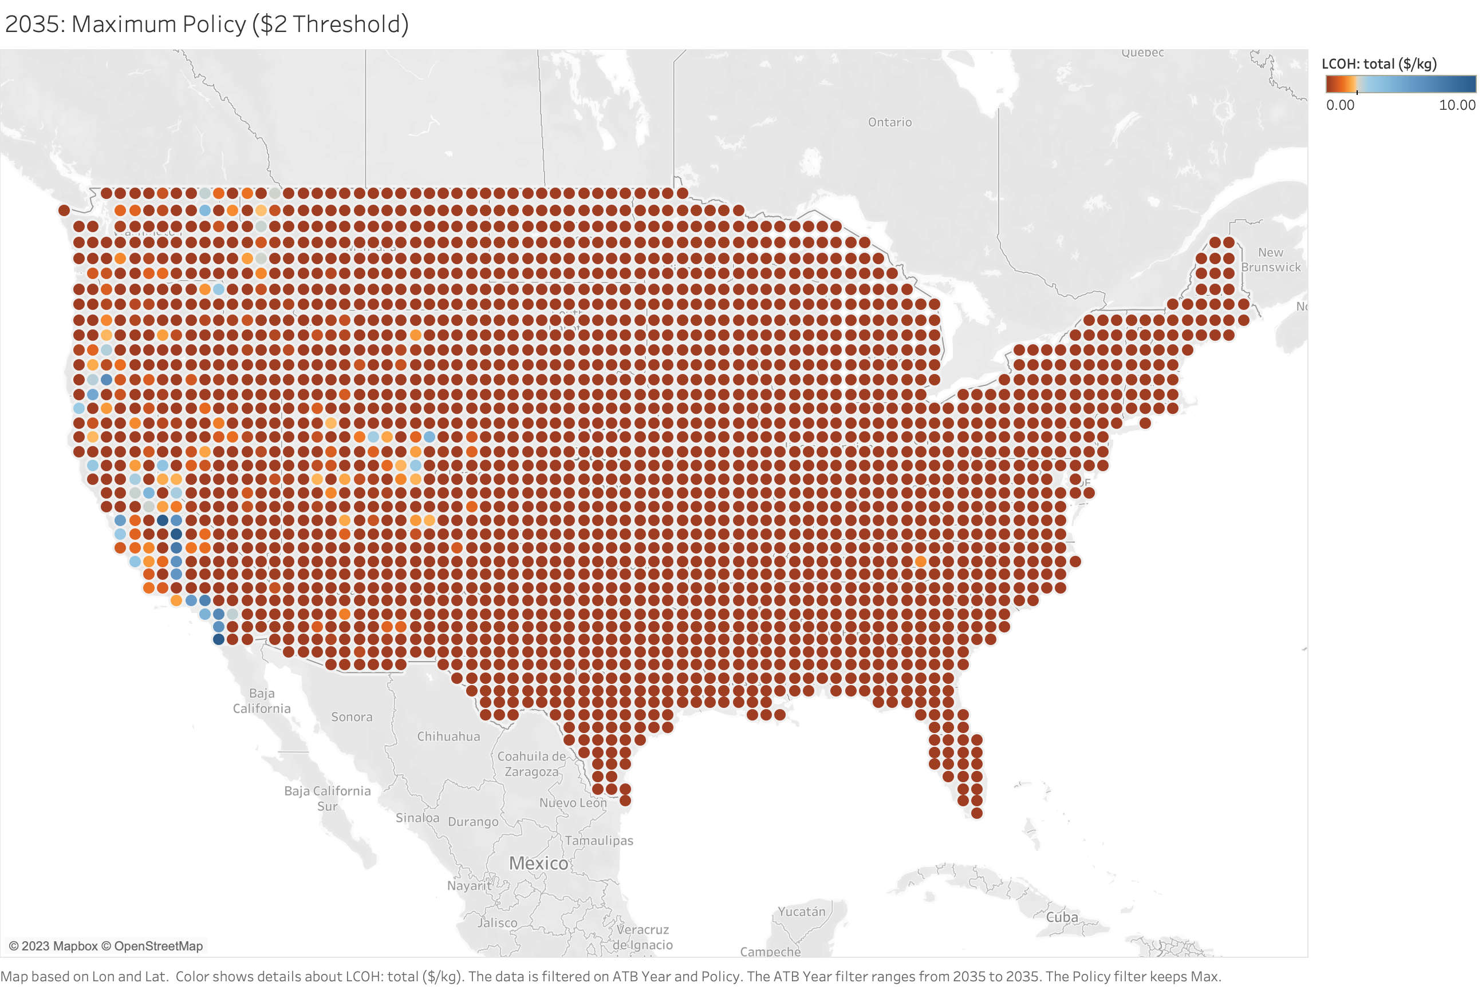

Slide 20
Turbine and Plant Losses
Wind Farm Capacity
Turbine Power Curve
Cost Data¹
Wind System Model
Location
WIND Toolkit
Wind Speed
PySAM
Wind Energy Generation
HOPP Wind Cost Model
Resource Year
Hub Height
Wind Plant Costs
Hydrogen System Model
Feedwater Consumption
Desalination Model
Freshwater Production
Electrolyzer Model
H₂ Produced
ProFAST
LCOH
Cost Data²
Electrolyzer System Capacity

